Slide 1
Taipei Sharing Bike (YouBike)
0852628 Dwilaksana Abdullah Rasyid

Slide 2

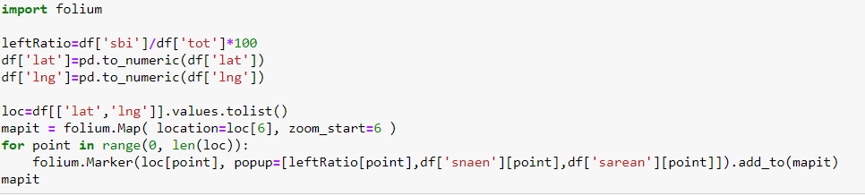
Taipei Sharing Bike (YouBike)
Change the web API
Make map with folium

Slide 3
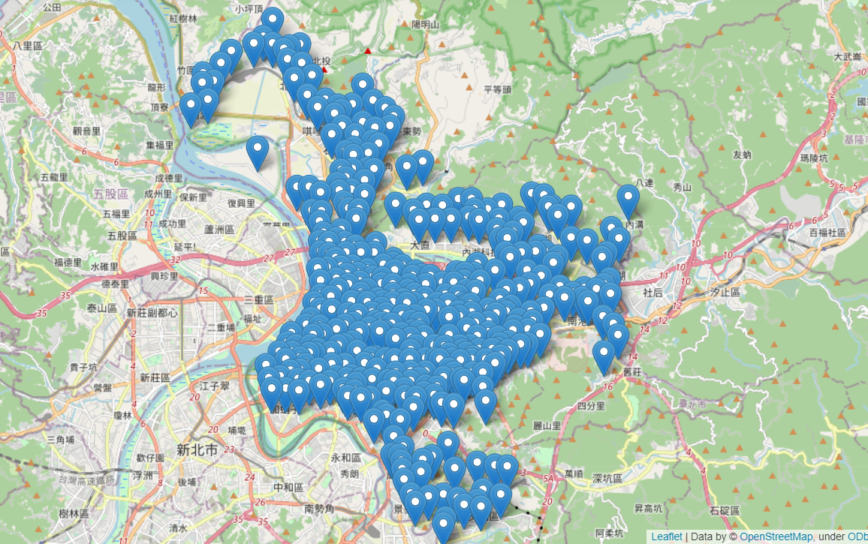
Results

